Slide 1

Week 5:
Keras and MNIST Handwritings
Machine Learning Using Tensorflow
Shu-Ting Pi, PhD
UC Davis

Slide 2
MNIST Handwriting Numbers

Slide 3
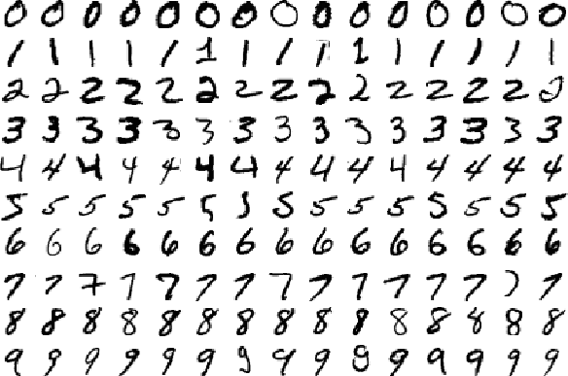
What is MNIST?
Human Handwriting Numbers
  - 60000 train set
  - 10000 test set
Each Picture
  - 28x28 pixels
Record High
  - 0.83% error via H2O.ai
Machine Learning using Tensorflow
Shu-Ting Pi

Slide 4
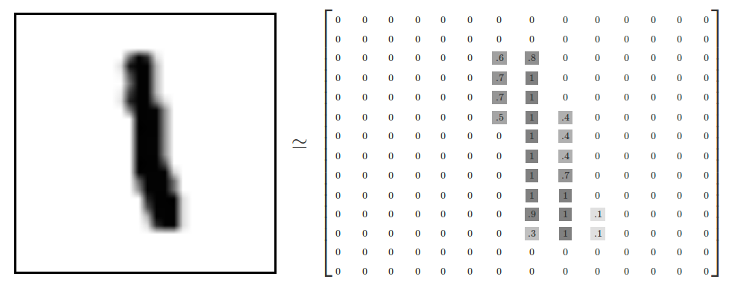
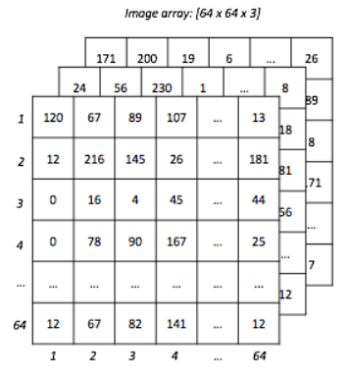
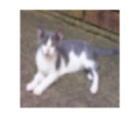
How to deal with pictures?
A figure is essentially a data array
Single Channel
Multi Channel (RGB)

Slide 5
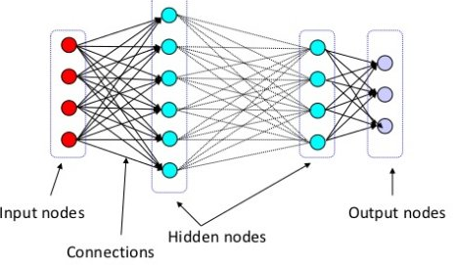
MINST Recognition Using MLP
Input dim = 784
Output dim = 10
S
O
F
T
M
A
X
Max

Slide 6
Keras

Slide 7





What is Keras
High-level API

Slide 8
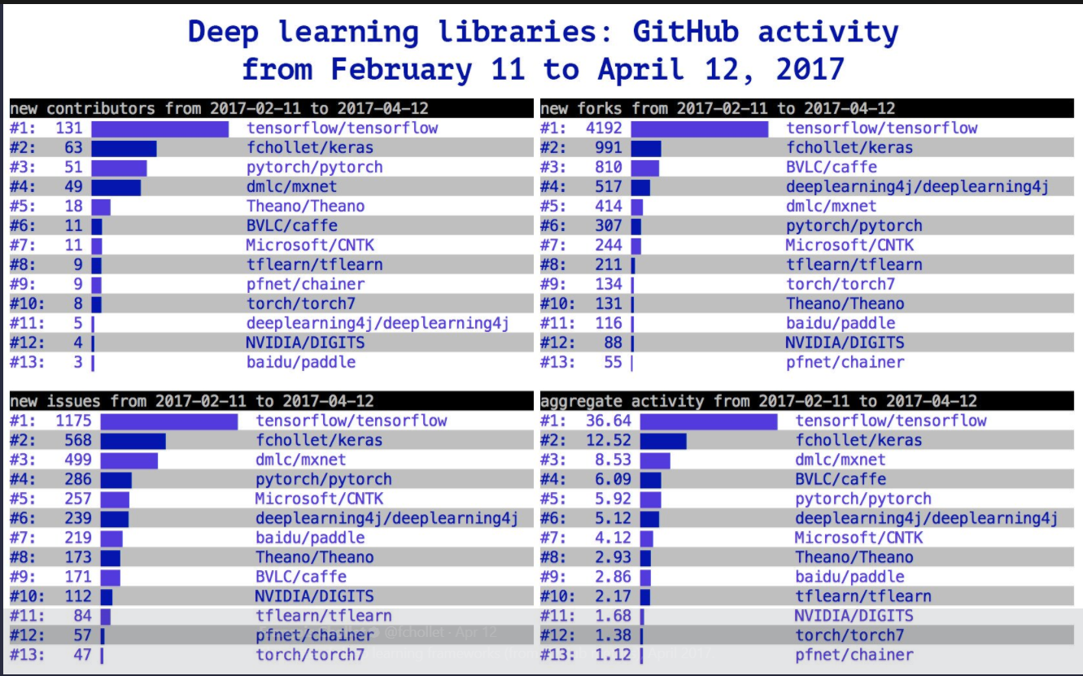
Fast Growing of Keras

Slide 9
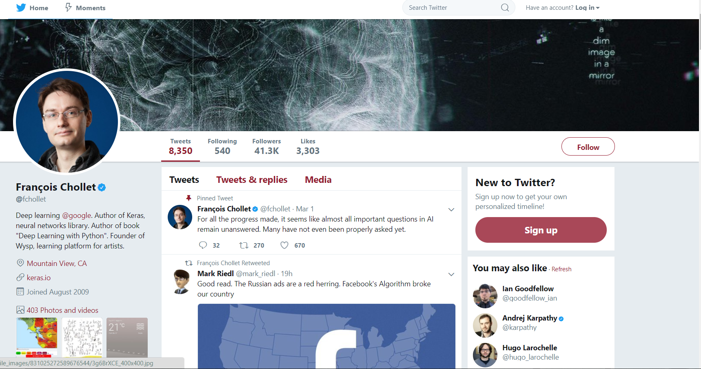
What is Keras

Slide 10
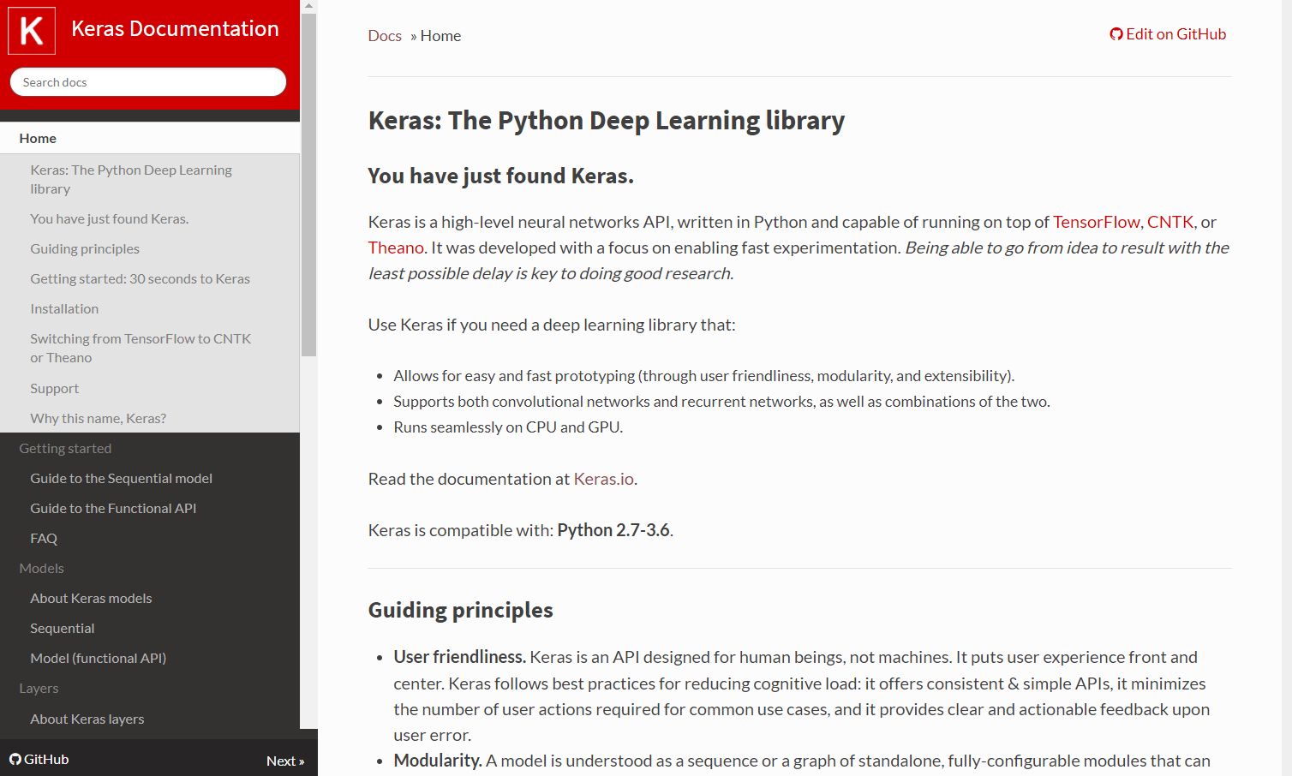

Official Resource of Keras

Slide 11
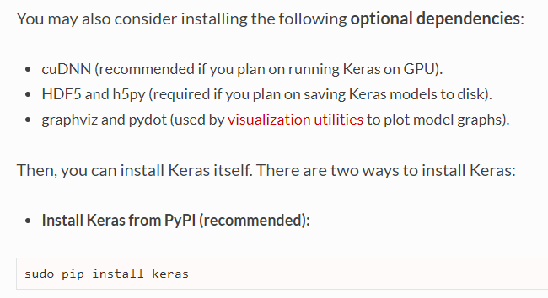

Installation

Slide 12
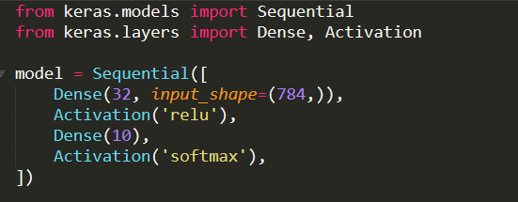
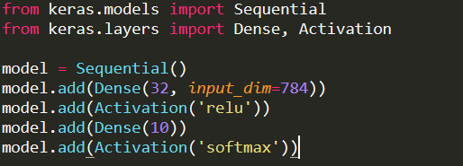
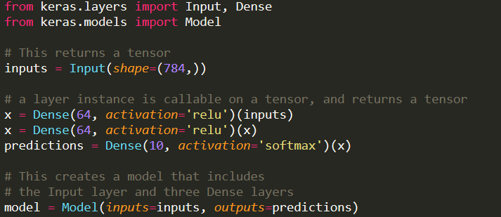
Models in Keras
Sequential Model
Using a list
Using add method
Functional API

Slide 13
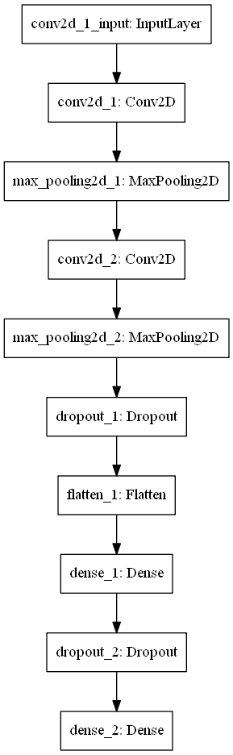
How to plot a model
Prerequisite
  - install graphviz
  - pip install graphviz, pip install pydot
How to
  - from keras.utils import plot_model
  - plot_model(model,to_file=’model.png’)

Slide 14
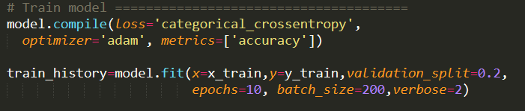
How to run a model
model.compile
  - define postprocess after output, e.g: loss, optimizer, metrics
model.fit
  - perform training
  - output will be an object contains train history

Slide 15
save and reload a model
Save model:
  - model.save(model,’model.h5’)
Reload model:
  - from keras.model import load_model
  - model=model.load(‘model.h5’)

